Slide 1
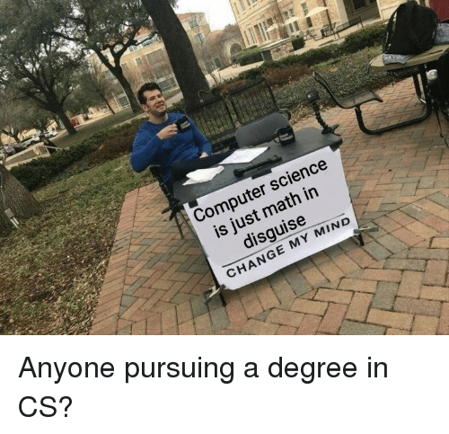

Slide 2
Lecture 3.1: Pointers
CS2308
Gentry Atkinson

Slide 3
Keeping Values in Memory
A computer’s memory can be thought of as one long list of integers.
Variables are named locations in memory.
How does the computer find that location though?

Slide 4
Memory Addresses
Every byte of memory has one fixed address.
Most variables occupy more than one byte.
A variable’s address is the address of its first byte.

Slide 5
Accessing Memory Addresses
The & operator can be used to access the address of a variable.
Addresses are show in “hexadecimal”.
int main(){
int X = 23;
cout << "X is stored at " << &X << endl;
return 0;
}

Slide 6
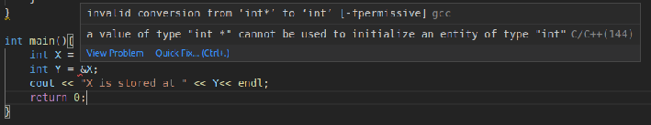
Storing an Address in a Variable
An address is just a number.
So logically, I should be able to store a memory address in a variable.
int main(){
int X = 23;
int Y = &X;
cout << "X is stored at " << Y<< endl;
return 0;
}

Slide 7
Pointers
Pointers are variables that hold the memory addresses of other variables.
A pointer can only point to variables of a particular data type.

Slide 8
Pointers are References
Changing the value stored in a pointer, changes the address it’s pointing to.
The * operator lets you change the value in the address it’s pointing to.
int main(){
int X = 23;
int* Y = &X;
cout << "Value in X: " << *Y << endl;
return 0;
}

Slide 9
Declaring Pointers
Every pointer should be given a specific data type.
Adding * between the datatype and the name of a variable makes it a ptr:
  char * c;

Slide 10
De-referencing Pointers
Accessing the location that a pointer points to is called “de-referencing”.
* is called the de-referencing operator.
You can think of * as meaning “in direction” or “at the location”.

Slide 11
Example 1
int main(int argc, char** argv){
int a = 1;
int* b = &a;
*b = 2*a;
*b = 2*(*b);
cout << "a is now " << *b << endl;
return 0;
} //try to predict the output

Slide 12
Pointer Arithmetic
Using operators to change the value stored in a pointer (the location it points to) is called “pointer arithmetic”.
Pointers can be made to point to any memory location, meaning that we have to be very careful with with pointer arithmetic.

Slide 13
Example 2
int main(int argc, char** argv){
int a[] = {1, 2, 3, 4, 5};
int* b = a;
cout << "b points to " << *b << endl;
b++;
cout << "Now b points to " << *b << endl;
b+=2;
cout << "Now b points to " << *b << endl;
return 0;
} //try to predict the output

Slide 14
Example 2 Walkthrough
0
0
1
2
3
4
5
0
0
0
0
0
int main(int argc, char** argv){
int a[] = {1, 2, 3, 4, 5};
int* b = a;
cout << "b points to " << *b << endl;
b++;
cout << "Now b points to " << *b << endl;
b+=2;
cout << "Now b points to " << *b << endl;
return 0;
} //notice the incrementing b moves it 4 bytes in memory.

Slide 15
The Terrible Truth about Arrays
int main(int argc, char** argv){
int a[] = {1, 2, 3, 4, 5};
cout << "Address of array first element: " << &a[0] << endl;
cout << "Value stored in a: " << a << endl;
cout << "First element in a: " << a[0] << endl;
cout << "Dereferencing a: " << *a << endl;
cout << "Second element in a: " << a[1] << endl;
cout << "Dereferencing a+1: " << *(a+1) << endl;
return 0;
} //try to predict the output

Slide 16

Arrays are Secretly Pointers
Really, they’re just similar.
An array variable points to the first address in its block of memory.
This is why arrays are indexed from 0.

Slide 17
Does Every Pointer Point to Something?
Remember that an uninitialized variable will have a “garbage” value left in it.
An uninitialized pointer is probably still pointing to a valid memory address though.
NULL or null_ptr are reserved pointer values that point to “nothing”.

Slide 18
Example 4
int main(int argc, char** argv){
int* p = NULL;
cout << "p points to " << p << endl;
cout << "the value at p " << *p << endl;
//segmentation fault
return 0;
} //try to predict the output

Slide 19
Always Check for NULL
Reading a NULL pointer is legal and encouraged:
  if (ptr != NULL)…
Writing to a NULL pointer will cause a run time error.

Slide 20
By-reference Using Pointers
//Double the value of a by reference parameter
void refFunc(int &X){
X *= 2;
return;
}
int main(int argc, char** argv){
int a =2;
refFunc(a);
cout << a << endl;
return 0;
} //try to predict the output
//Same thing but with pointers
void ptrFunc(int* X){
*X *= 2;
return;
}
int main(int argc, char** argv){
int a =2;
ptrFunc(&a);
cout << a << endl;
return 0;
} //try to predict the output

Slide 21
Returning Pointers from Functions
int* makeAnInt(){
int a = 3;
int* b = &a;
return b;
}
int main(int argc, char** argv){
int* b = makeAnInt();
cout << "b is " << *b << endl;
} //This program causes an error!

Slide 22
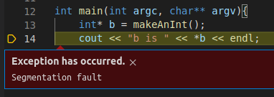
Returning Pointers from Functions
The function makeAnInt() creates a variable in memory and then returns the address of that variable.
That variable goes out of scope when the function returns and can no longer be referenced.

Slide 23
Questions or Comments?

